Slide 1
Introduction to Quantum Computing: From a Layperson to a Programmer in 30 Steps
Hiu-Yung Wong
https://link.springer.com/book/10.1007/978-3-030-98339-0
https://www.amazon.com/Introduction-Quantum-Computing-Layperson-Programmer/dp/3030983382
Playlist: https://www.youtube.com/watch?v=Rn8jdDYStws&list=PLnK6MrIqGXsJfcBdppW3CKJ858zR8P4eP&index=44
https://www.youtube.com/watch?v=RkHlv_fzx_E&list=PLnK6MrIqGXsJfcBdppW3CKJ858zR8P4eP&index=45

Slide 2
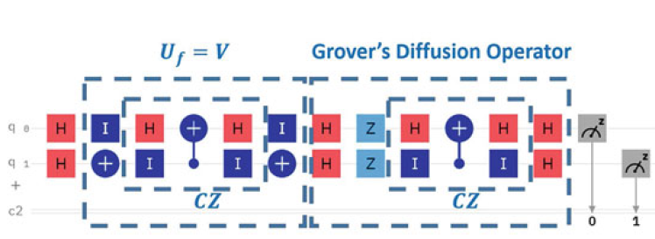

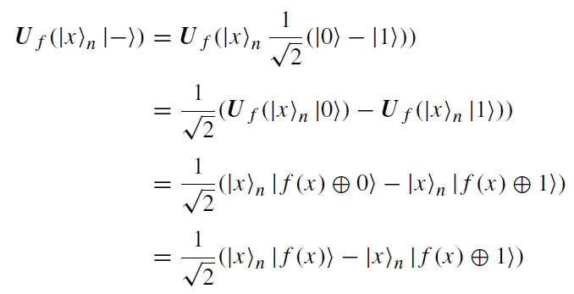


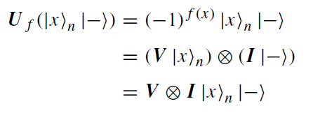


Using XOR Quantum Oracle U_{f} to implement V
Regardless of the value of f (x)

Slide 3
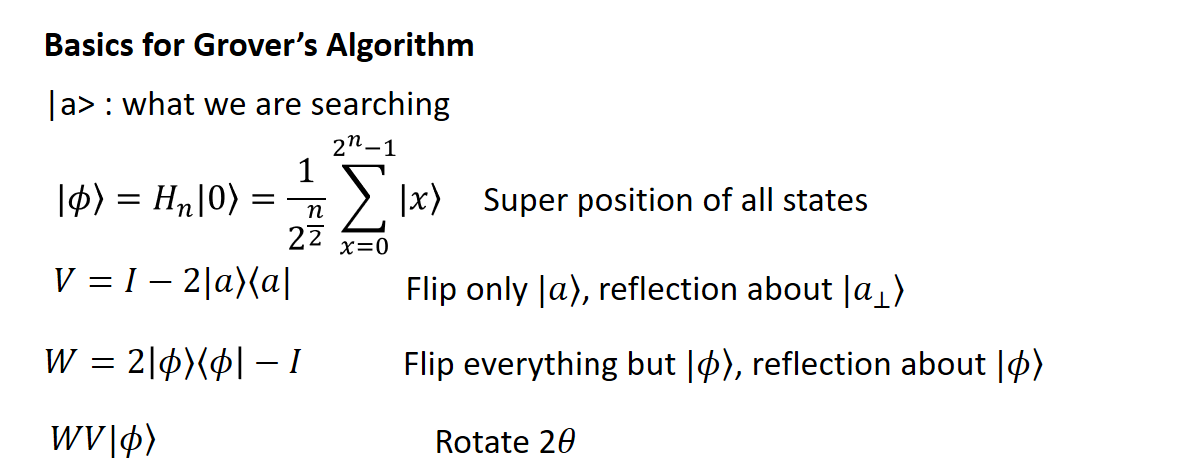
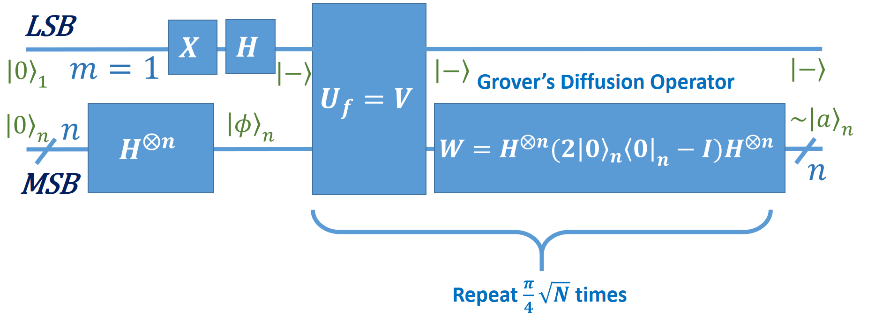
Grover’s Circuit

Slide 4
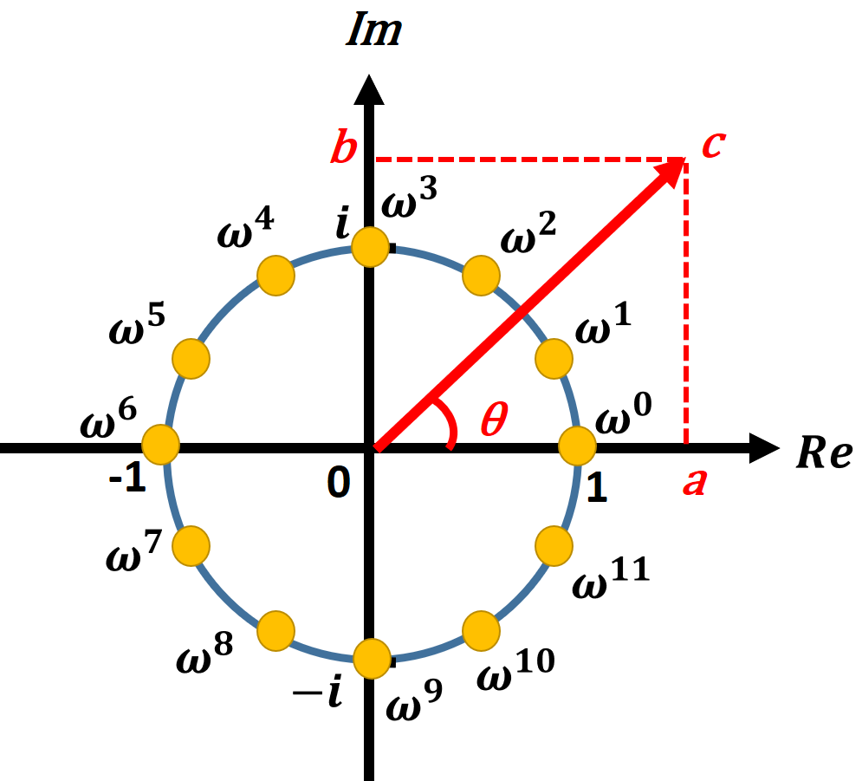







N-th Root of Unity

Slide 5
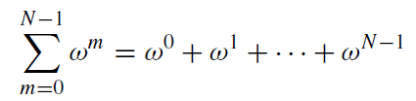


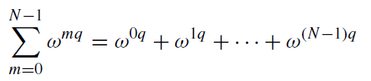
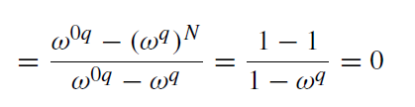

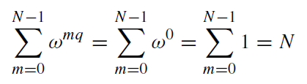
Properties of the N-th Root of Unity
1)
destructive interference
2)
3)
constructive interference
4)

Slide 6
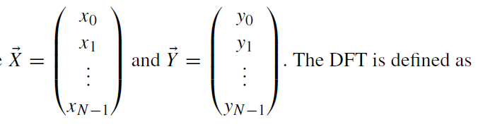
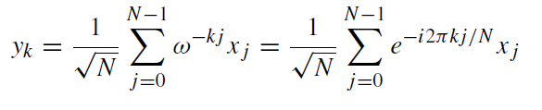


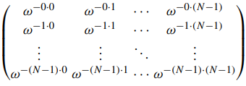

Discrete Fourier Transform
Given a vector:

Slide 7
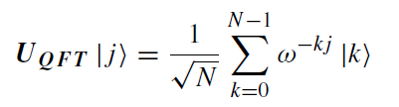
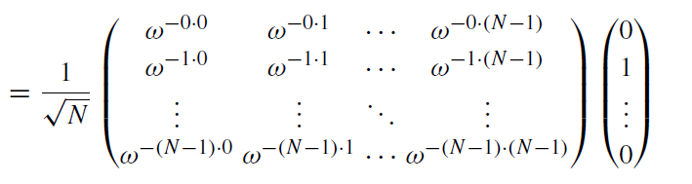
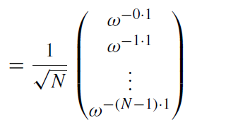

Quantum Fourier Transform
Def

